Slide 1
HeatSafe Checkpoint
Product Backlog — from a Product Owner's perspective
Team 5 • D'Andre League · James Hawkins · Teyana Williams · Ryan Tucker • CINS 5338/5388 • Sept 17, 2026

Slide 2
WHAT WE'LL COVER
Agenda
• 1 — From Developer to Product Owner: how the backlog voice changed
• 2 — Sprint 0 recap: System scope, use-case diagram, AI Priority Matching (Done)
• 3 — Updated use-case diagram: all 7 actors, built + planned, checked against real Jira
• 4 — Product backlog by epic: built, in review, and newly planned
• 5 — Points-per-actor tally: recalculated from the real Jira Story Points field
• 6 — Sprint 1/2 remodel: System Administrator voice, technical leads, subtasks
• 7 — Priority Access & Resident Matching, and the three autonomous agents
• 8 — New backlog: Caregiver, Volunteer, Cooling Center Staff, ride-matching, reporting
• 9 — Scrum team & Kanban board alignment
• 10 — Outstanding items — what we need to close out
HeatSafe Checkpoint • Team 5 • CINS 5338/5388
2

Slide 3
1 — REFRAMING THE BACKLOG
From Developer to Product Owner
• The original backlog was written in developer voice — "Dev: build X" — which describes work, not value.
• Every built and in-review story (SCRUM-12 through SCRUM-54) has been rewritten in user-perspective voice: "As a <actor>, I want <capability>, so that <benefit>."
• Internal/infrastructure work that has no single named end-user beneficiary is now voiced as the System Administrator — replacing the generic "Team" framing used before.
SCRUM-37, before: “Team: need-scoring rubric and its data-handling rules documented.”
SCRUM-37, after: “As a 'System Administrator', we want the need-scoring rubric and its data-handling rules documented, so the weights can be defended in review and the PII decisions are deliberate rather than accidental.”
HeatSafe Checkpoint • Team 5 • CINS 5338/5388
3

Slide 4
2 — SPRINT 0 RECAP (CARRIED FORWARD UNCHANGED)
System Scope & AI Priority Matching
• Use-case diagram: 7 actors — Resident, Caregiver, Volunteer, Coordinator, Cooling Center Staff, System Administrator, AI Agent (updated version on the next slide).
• AI Priority Matching epic (SCRUM-8) — 6/6 stories Done, 21 points, epic status corrected to Done in Jira this pass.
– SCRUM-12 areas table + seed data · SCRUM-13 vulnerability scoring function · SCRUM-14 distance-adjusted ranking
– SCRUM-15 admin priority-areas table · SCRUM-16 resident map shading · SCRUM-17 methodology documentation
• Sprint 0 retro gap — “no cooling/water site records were ever seeded” — closed by SCRUM-27/28: 11 real Texas relief sites (Houston, Dallas, Fort Worth, Austin, San Antonio).
• Pilot region moved from the original Los Angeles placeholder to the Texas pilot footprint used everywhere in this deck.
HeatSafe Checkpoint • Team 5 • CINS 5338/5388
4

Slide 5
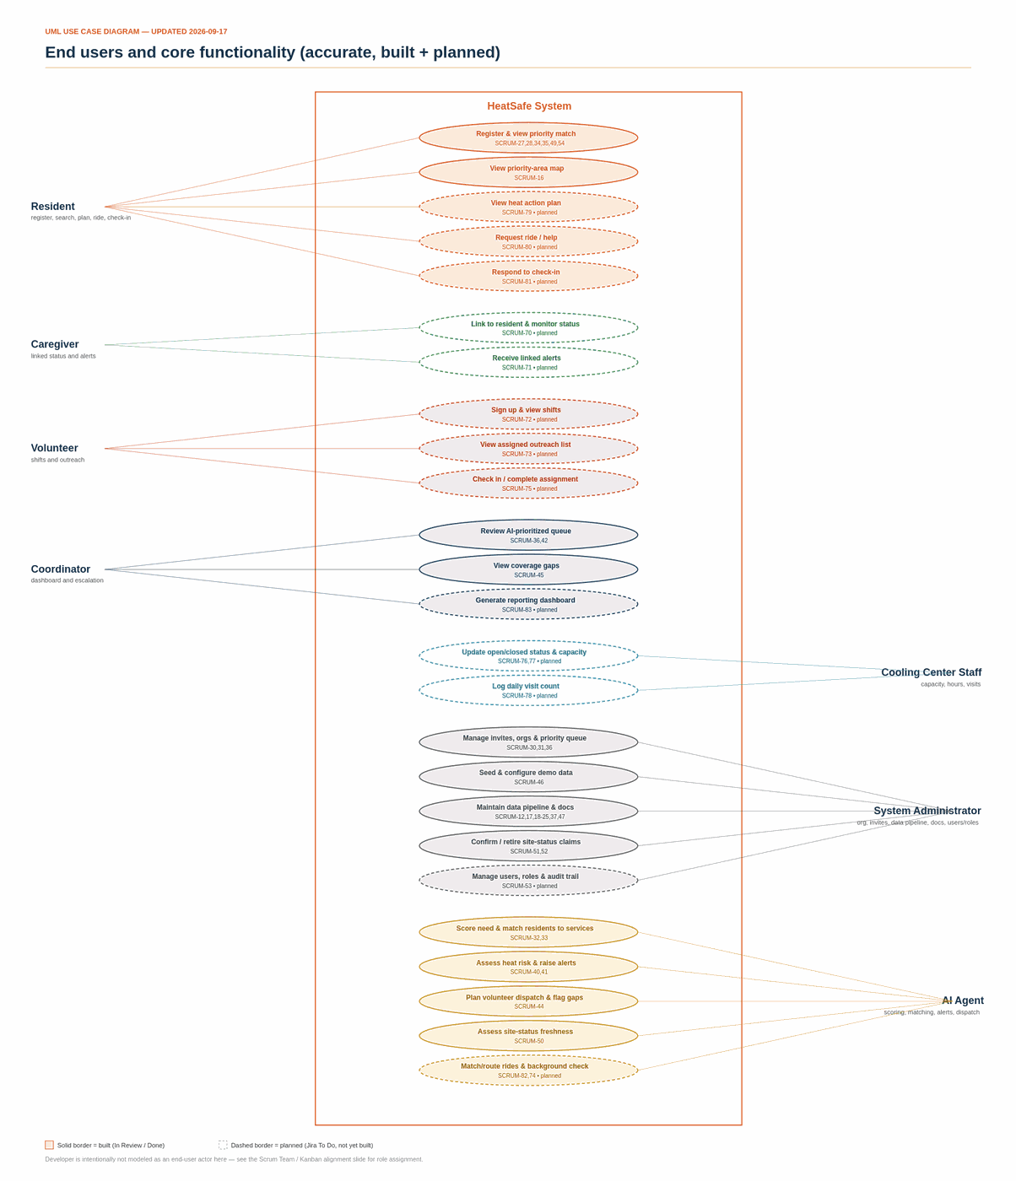
3 — A MORE ACCURATE DIAGRAM, CHECKED AGAINST JIRA
Updated Use-Case Diagram
HeatSafe Checkpoint • Team 5 • CINS 5338/5388
5

Slide 6
3 — METHODOLOGY
Why the Diagram and the Points Tally Use Different Boundaries
• The diagram groups use cases the way the team's original sketch did — e.g. the Checkr background check and external weather/forecast retrieval sit under AI Agent, matching the original screenshot's own convention.
• The points-per-actor tally (next section) uses a stricter definition: only the three agents actually documented in docs/AGENTS.md (Heat Watch, Dispatch Planner, Site-Status Freshness) plus the need-scoring/service-matching engines count as “AI Agent” work. Data-plumbing that feeds them — Census/ACS integration, weather API integration — is counted as System Administrator infrastructure, since that is the persona voice those specific Jira stories were rewritten into.
• Both views are internally consistent; they just answer different questions — “who does the diagram say performs this” versus “who does the actual codebase and Jira backlog say owns this.”
HeatSafe Checkpoint • Team 5 • CINS 5338/5388
6

Slide 7
4 — PRODUCT BACKLOG BY EPIC
Built & In-Review Epics
Epic | Key | Status | Stories | Points
AI Priority Matching | SCRUM-8 | Done | 6 | 21
Live Weather Integration | SCRUM-10 | In Progress | 3 | 8
Demographic Integration | SCRUM-11 | In Progress | 5 | 12
Site Directory — Texas Pilot | (SCRUM-27/28) | In Review | 2 | 8
Priority Access & Resident Matching | SCRUM-29 | In Review | 8 | 39
Heat Emergency Watch Agent | SCRUM-38 | In Review | 4 | 16
Outreach Dispatch Planner Agent | SCRUM-39 | In Review | 4 | 19
Site Status Freshness Agent | SCRUM-48 | In Review | 3 | 11
Search-radius defect fix | SCRUM-49 | In Review | 1 | 2
County header / alert UX | (SCRUM-54) | To Do | 1 | 5
HeatSafe Checkpoint • Team 5 • CINS 5338/5388
7

Slide 8
4 — PRODUCT BACKLOG BY EPIC
Newly Planned Epics — Filling the Diagram's Gaps
• The original diagram named Caregiver, Volunteer, Cooling Center Staff, and a ride-matching capability that had zero backlog coverage. Rather than leave them undiagrammed, real Jira epics and stories were created — all To Do, unassigned, honestly scoped as planned work, never marked done.
Epic | Key | Stories | Points
Caregiver Portal | SCRUM-67 | 2 | 8
Volunteer Portal & Assignment Workflow | SCRUM-68 | 4 | 13
Cooling Center Staff Self-Service | SCRUM-69 | 3 | 12
Organization User Accounts & Audit Trail | SCRUM-53 | 0 (not yet broken down) | —
Standalone: heat action plan, ride request, wellness check-in (Resident) | SCRUM-79–81 | 3 | 9
Standalone: ride-matching agent (AI Agent) | SCRUM-82 | 1 | 8
Standalone: coordinator reporting dashboard | SCRUM-83 | 1 | 5
HeatSafe Checkpoint • Team 5 • CINS 5338/5388
8

Slide 9
5 — RECALCULATED PER THE DIAGRAM
Points per Actor
Actor | Built (In Review/Done) | Planned (To Do) | Total
System Administrator | 70 | 0 | 70
AI Agent | 42 | 8 | 50
Resident | 26 | 9 | 35
Volunteer | 0 | 13 | 13
Cooling Center Staff | 0 | 12 | 12
Coordinator | 6 | 5 | 11
Caregiver | 0 | 8 | 8
Total | 144 | 55 | 199
Bucketed by who performs the use case, not just who the story's “As a …” line names — e.g. SCRUM-33's service-matching algorithm counts as AI Agent work even though it's framed “As a resident.” Verified: sums to an exact, independently-computed 199 across every non-epic, non-subtask Jira issue.
HeatSafe Checkpoint • Team 5 • CINS 5338/5388
9

Slide 10
6 — SPRINT 1 REMODEL
Live Weather & Demographic Integration — System Administrator Voice
• All 11 Sprint 1 stories (SCRUM-18–26) reframed from “Dev: …” to “As a 'System Administrator', I want …” — same acceptance criteria and dev tasks, now traceable to a persona instead of a role label.
• A Subtask was added under each reframed story carrying its original “Development Tasks” bullets — SCRUM-55 through SCRUM-66 — so the acceptance-criteria-level story and the line-by-line developer task are separate, board-visible items.
• Technical leads (unchanged from the team's own Sprint 1 plan):
Assignee | Role | Points | Stories
James Hawkins (JH) | Engineer | 12 | SCRUM-18–22 — Demographic Integration (full epic)
Ryan Tucker (RT) | Developer | 5 | SCRUM-23 — Weather API module
Teyana Williams (TW) | Developer | 4 | SCRUM-25, SCRUM-26 — Weather fallback + cross-cutting recompute
D'Andre League (DL) | Scrum Master | 2 | SCRUM-24 — Weather response caching
HeatSafe Checkpoint • Team 5 • CINS 5338/5388
10

Slide 11
7 — SPRINT 2
Priority Access & Resident Matching (SCRUM-29)
• Scores people, not places — SCRUM-8 ranks neighborhoods; this epic ranks which registered resident needs help first and what kind, using the same transparent, rule-based philosophy.
• 8 stories, 39 points, currently In Review: invite codes (30) · resident registration (31) · need-scoring agent (32) · service matching (33) · registration UX (34) · results panel (35) · admin priority queue (36) · scoring-rubric documentation (37).
• Explainability is a design constraint, not a nice-to-have: this feature prioritizes access to a life-safety resource, so every score ships with the plain-language reasons behind it.
• PII discipline: raw income never appears in list endpoints, logs, or the admin queue — only an income band. Registration requires explicit, unchecked-by-default consent.
HeatSafe Checkpoint • Team 5 • CINS 5338/5388
11

Slide 12
7 — SPRINT 4 (SEQUENCED AFTER SPRINT 2)
The Three Autonomous Agents
Agent | Key | What it decides | Points
Heat Emergency Watch | SCRUM-38 | Escalates an area's severity when it is both vulnerable AND has no open site within 8km — never on either condition alone. | 16
Outreach Dispatch Planner | SCRUM-39 | Builds a volunteer outreach plan from scheduled shifts, highest-need areas first; flags coverage gaps. | 19
Site Status Freshness | SCRUM-48 | Ranks which site-status claims to reconfirm first — staleness windows tighten as heat rises. | 11
Documented boundary (docs/AGENTS.md): no agent contacts a resident directly. All three produce lists and alerts for a human — a coordinator or org admin — to act on or override. That boundary is deliberate and is meant to survive future changes.
Escalation rule, exactly as implemented: vulnerable = risk_score ≥ 28 (calibrated against real Texas scores, not a round 40) AND uncovered = no open site within 8km. Both required; escalation is capped at one step.
HeatSafe Checkpoint • Team 5 • CINS 5338/5388
12

Slide 13
8 — NEW BACKLOG
Caregiver, Volunteer, Cooling Center Staff & Ride-Matching
• Caregiver Portal (SCRUM-67, 8 pts) — link to a resident with consent, monitor their status, receive the same alerts they would.
• Volunteer Portal & Assignment Workflow (SCRUM-68, 13 pts) — shift signup, assigned outreach list, in-shift check-in, and a Checkr background-check gate before an in-person assignment.
• Cooling Center Staff Self-Service (SCRUM-69, 12 pts) — site-scoped status/capacity updates and a daily visit counter, without full admin-portal access.
• Ride-matching agent (SCRUM-82, 8 pts) — the diagram's “Match cooling ctr, route, and transportation” bubble, built on the existing service-matching and dispatch logic.
• Coordinator reporting dashboard (SCRUM-83, 5 pts) — one read-only rollup of dispatch coverage, site freshness, capacity, and volunteer contact-log completion by area.
• All 17 new issues are To Do and unassigned — real, ready-to-groom backlog, not fabricated progress.
HeatSafe Checkpoint • Team 5 • CINS 5338/5388
13

Slide 14
9 — TEAM ALIGNMENT
Scrum Team & Kanban Board Alignment
Name | Scrum Role | Jira Account
D'Andre League | Scrum Master | dleague
James Hawkins | Engineer | jwhawkins@pvamu.edu
Teyana Williams | Developer | Teyana Williams
Ryan Tucker | Developer | Tucker, Ryan
• Kanban columns match the Jira workflow exactly: To Do → In Progress → In Review → Done (transition IDs 11/21/31/41) — no shadow status lives outside Jira.
• Jira has no Bug issue type. Defects are filed as Tasks prefixed “DEFECT —” (see SCRUM-49) so they still carry acceptance criteria and points.
• Epic-level status hygiene was corrected this pass — SCRUM-8 moved to Done and SCRUM-29/38/39/48 moved to In Review to match their children, so the board's epic swimlanes now tell the truth at a glance.
HeatSafe Checkpoint • Team 5 • CINS 5338/5388
14

Slide 15
10 — WHAT WE NEED FROM THE TEAM
Outstanding Items
• Groom & assign the 17 new planned issues (SCRUM-67–69, 70–83) to owners — currently unassigned by design, per the team's own decision to keep new backlog honestly To Do.
• SCRUM-53 (Organization User Accounts & Audit Trail) has no stories yet — needs breakdown before it can be pointed.
• Confirm who owns Checkr sandbox credentials for SCRUM-74 before that story is picked up.
• A stale .git/index.lock on James's machine is blocking one pending commit (corrected docs/AGENTS.md + docs/NEED-SCORING.md) — needs a manual clear, exact commands already handed off.
• Run the local seed (seed_areas.sql + seed_sites.sql) and merge the site-directory PR so the map/admin screenshots stop showing the old Los Angeles placeholder data.
• Decide whether the 4 SharePoint/local presentation files this deck supersedes (Team5_Sprint0_Presentation, HeatReliefNetwork_Checkpoint, HeatReliefNetwork_Checkpoint-1, HeatSafe_Progress_Update) should be archived now that everything is consolidated here.
HeatSafe Checkpoint • Team 5 • CINS 5338/5388
15

Slide 16
Thank You — Questions?
HeatSafe — Team 5 • CINS 5338/5388

